Slide 1
Welcome to all

Slide 2
Project name: India’s agricultural crop production

Slide 3
Introduction: 1.1overview An evolutionary process that consists of series of activities such as production of food 1.2 purpose Source of food

Slide 4
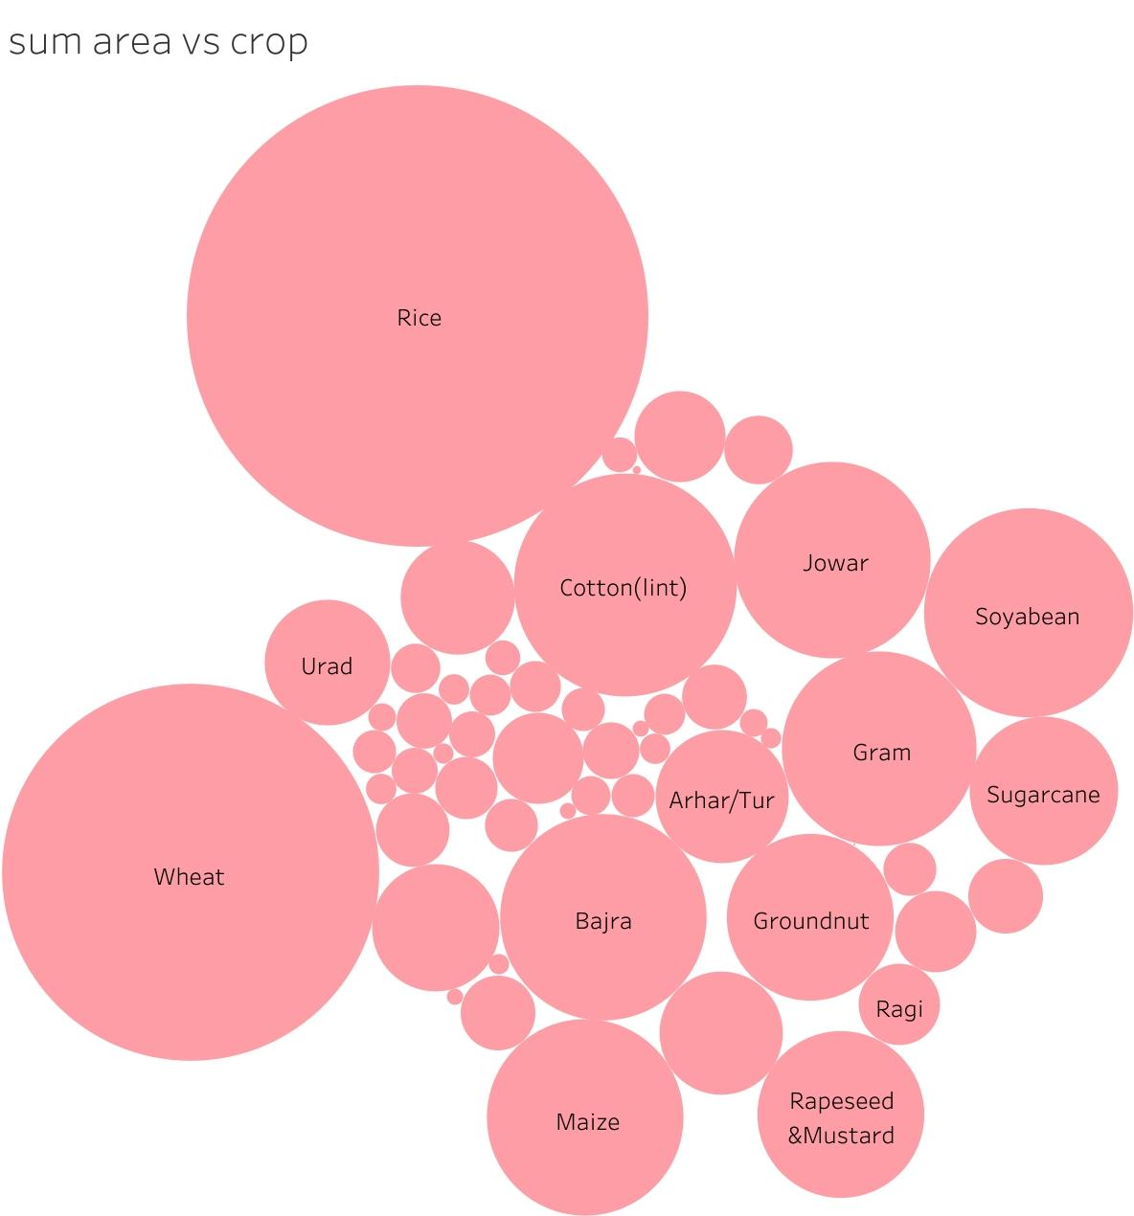
Result:

Slide 5
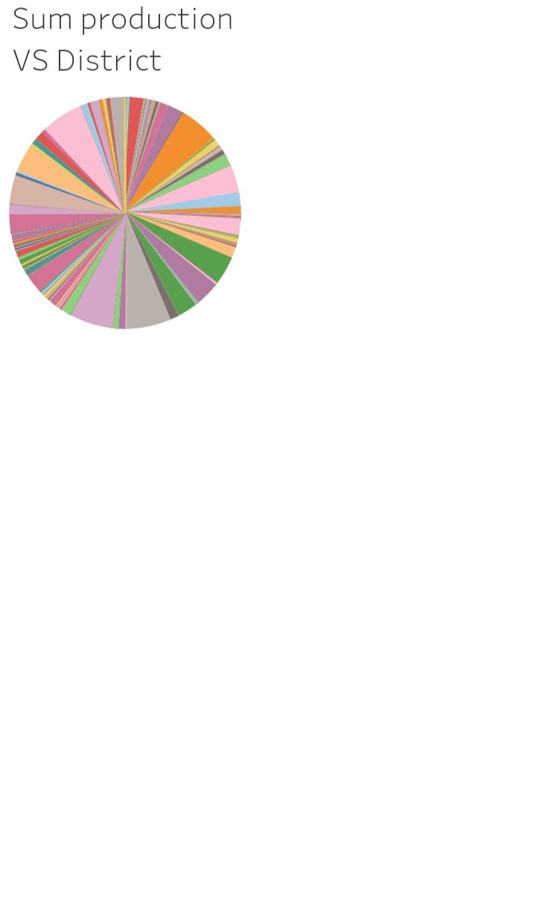

Slide 6
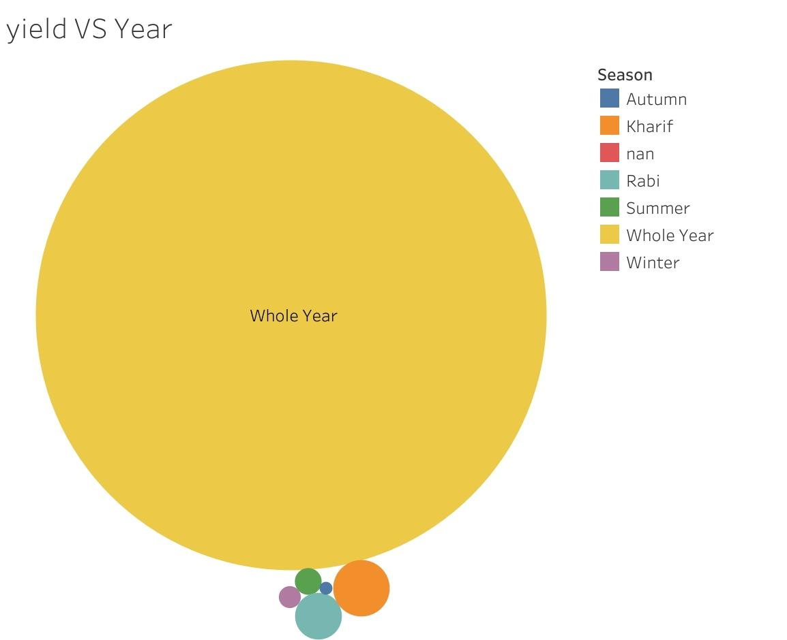

Slide 7
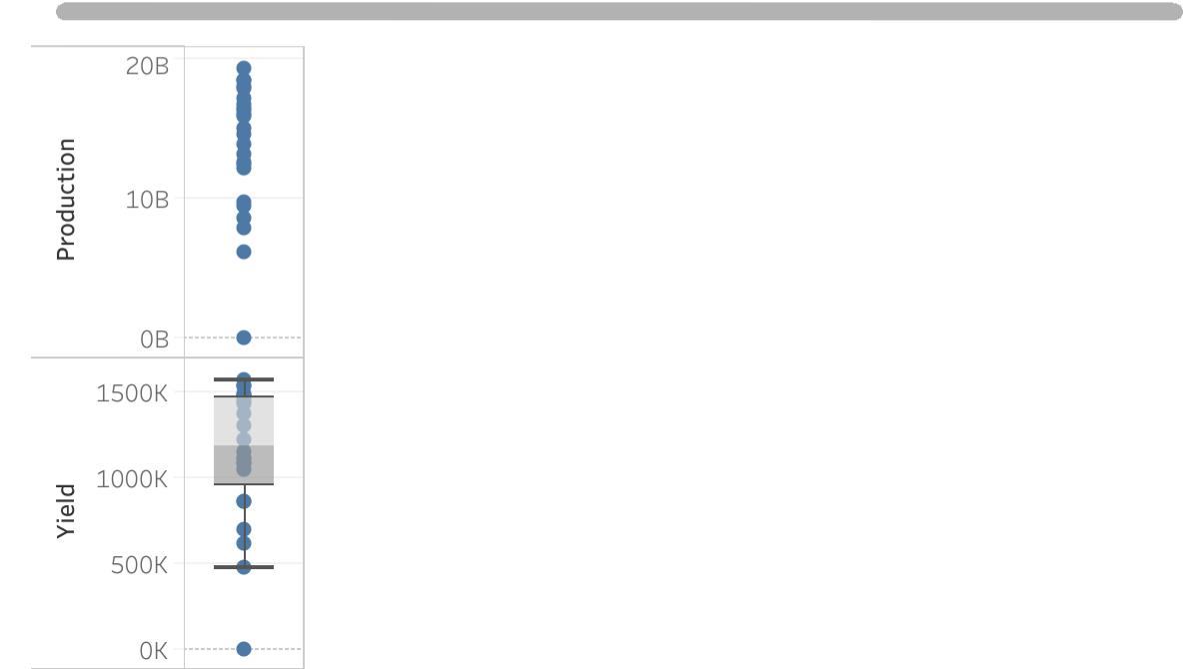

Slide 8
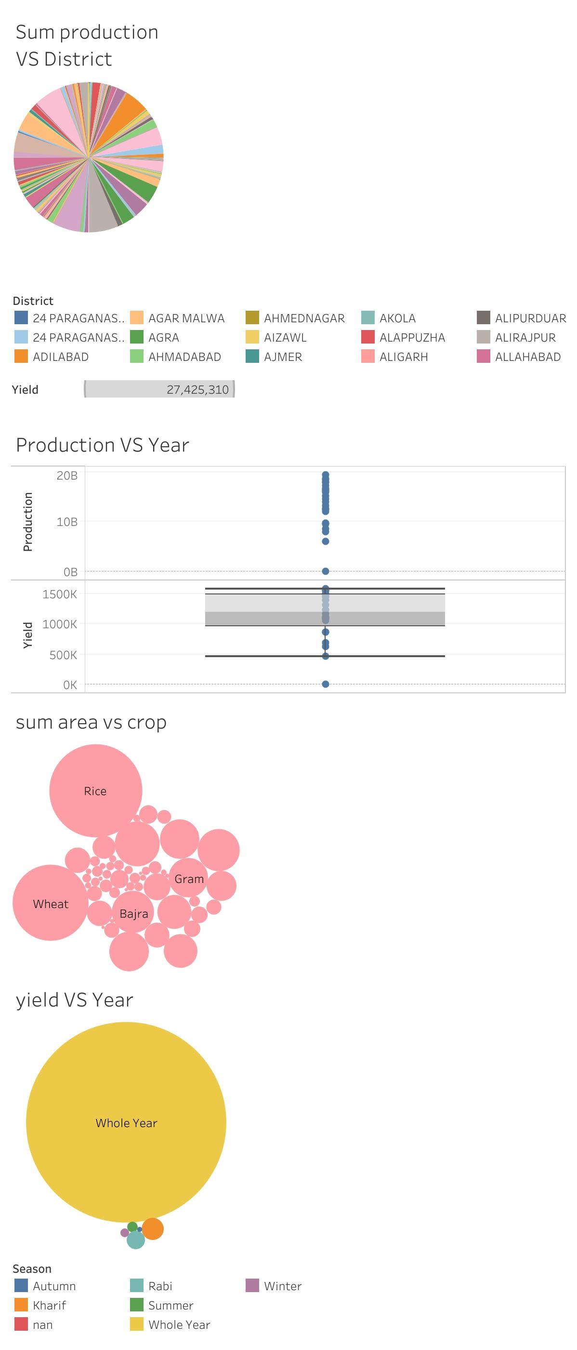
Dashboard:

Slide 9
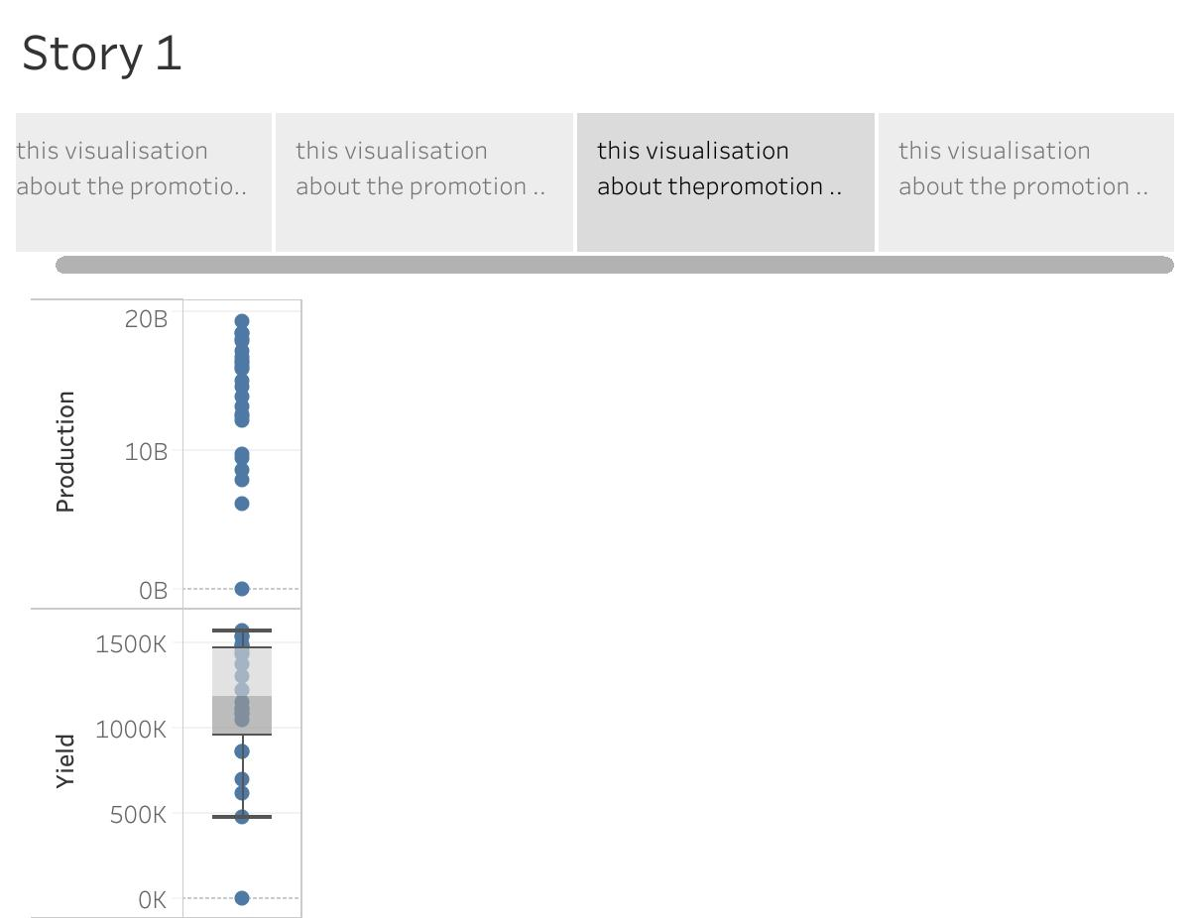
Story

Slide 10
Advantages: *Increases soil fertility . *Increases crop yield *Increases soil nutrient

Slide 11
Disadvantages: *Involved risk *Requires more knowledge

Slide 12
Application: The agricultural sector forces on food productions and supplies food to feed a country’s growing population

Slide 13
Conclusion: Agriculture has given so much to society . It is very important to indian economy

